Slide 1
Addressing obesity in children and youth
Janice Selekman DNSc, RN, NCSN, FNASN
Professor Emerita, University of Delaware

Slide 2
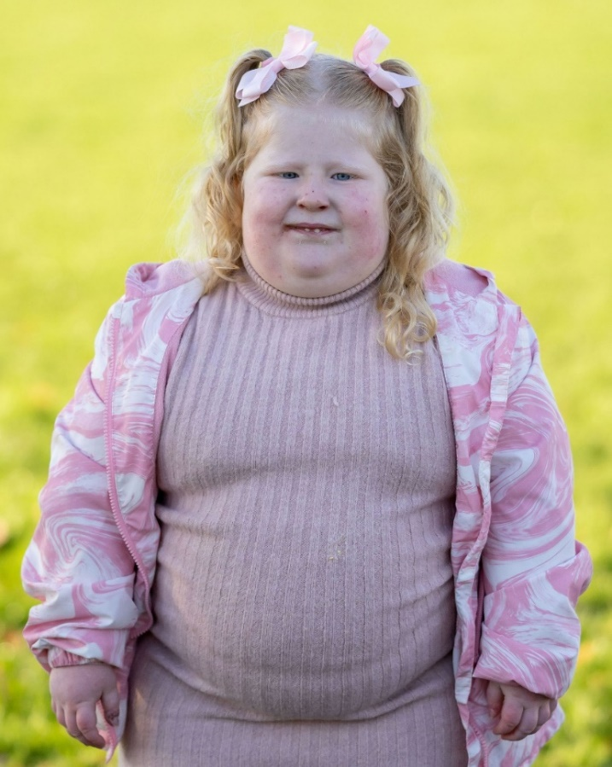
Start with some questions
Is overweight the new normal?
Is obesity a disease?
Is obesity a disability?
Does it warrant legal protection against
discrimination?
Is obesity a lifestyle choice?
Is obesity an addiction?
Whose fault is it?
Why is losing weight so hard?
Why are overweight and obesity so challenging and frustrating to treat?

Slide 3
Obesity IS a Disease
As of 2013, the American Medical Association formally recognized obesity as a chronic disease requiring medical interventions
Some consider it to be one of the most common chronic conditions of childhood
Overweight and Obesity defined by the World Health Organization as “abnormal or excessive fat accumulation that may impair health” (2022)
Overweight and Obesity are labels for ranges of weight that are greater than what is considered healthy and have been shown to increase the likelihood of certain diseases and other health problems (CDC)

Slide 4
Obesity Medicine Association: Definition of Obesity
“a chronic, relapsing, multi-factorial, neurobehavioral disease, wherein an increase in body fat promotes adipose tissue dysfunction and abnormal fat mass physical forces, resulting in adverse metabolic, biomechanical, and psychosocial health consequences”

Slide 5
Body Mass Index (BMI)
Index of weight for height commonly used to classify overweight and obesity
NOT a direct measure of body fat, but rather an estimate of adiposity
A practical way to measure and describe
It underestimates obesity compared to more sensitive measures of fat volume
Only uses height and weight
Used as a gatekeeper metric for treatment eligibility by insurance (medications and bariatric surgery)

Slide 6
BMI percentiles in children
For children of the same gender and age,
Percents are used with children because body composition changes with age and therefore children are compared to others of same age and gender
Therefore, boys in the 95th percentile for age would have a BMI greater than 95% of boys his age
Underweight = <5th percentile
Normal = BMI as defined on the CDC growth charts between 5th and 84th percentile
Overweight = BMI between 85th and 94th percentile
Obesity = BMI at or above the 95th percentile

Slide 7
BMI for adults
By age 18, the 95th percentile of BMI on CDC growth charts corresponds approximately to a BMI of 30 kg/m2
Normal BMI = 18.8-<25 kg/m2
Overweight BMI = 25 - < 30 kg/m2
Obesity
Class I = BMI of 30-<35 kg/m2
Class 2 = BMI of 35-<40 kg/m2
Class 3 = BMI of 40 or higher kg/m2

Slide 8
Morbid Obesity
Defined as > 80-100 pounds over ideal body weight or > 40 BMI
Term was coined in 1963 to persuade health insurance companies that reimbursement for the cost of intestinal bypass surgery in grossly obese patients could be justified on health grounds

Slide 9
Problems with BMI
Does not take into account muscle mass, bone density, and overall body composition
Inaccurate for athletes
Exaggerates thinness in short people, giving the impression that they are thinner than they are
Exaggerates adiposity in tall people, giving the impression of being larger than they actually are
Does not indicate where the fat is, an important determinant of the cardiometabolic consequences of fat

Slide 10
More sensitive measures to measure adiposity
“BMI should be used in conjunction with other valid measures of risk, such as, but not limited to measurements of visceral fat, body adiposity index, body composition, relative fat mass, waist circumference, and genetic/metabolic factors” (AMA)
Visceral fat is stored in abdomen (liver, stomach, intestines) and arteries; active fat [subcutaneous fat] is under skin and easier to see)
Bioelectrical impedance (uses electrical current to measure adiposity)
Densitometry (underwater measurement of weight)
Dual energy x-ray absorptiometry (DXA)
Possible: Tri-ponderal mass index (TMI)
Divide body weight by height cubed, especially for 8-11 year olds

Slide 11
THEREFORE, BMI IS GOOD FOR ASSESSMENT OF POPULATIONS AT RISK FOR CARDIOVASCULAR DISEASE….BUT NOT HELPFUL AT THE INDIVIDUAL LEVEL.
ONE SIZE DOES NOT FIT ALL
June 2023 – American Medical Association
Pay less attention to BMI in determining if a patient is at a healthy weight
BMI does not predict disease risk equally well across racial and ethnic groups

Slide 12
Prevalence of Overweight and Obesity
1990s saw first reports of increase in overweight in society that started in the late 1970s
Prior to 2012, NO states had >35% obesity
2022-obesity >35% in 22 states (2017–obesity >35% in 7 states)
Obesity increased 70% in past 30 years for adults; 85% for children
More among minority and disadvantaged
Adults: 41.9% obese; 73.6% overweight and obese
Obesity was 30.5% of population in 2000
Young adults = 33% (was 6% in 1976)

Slide 13
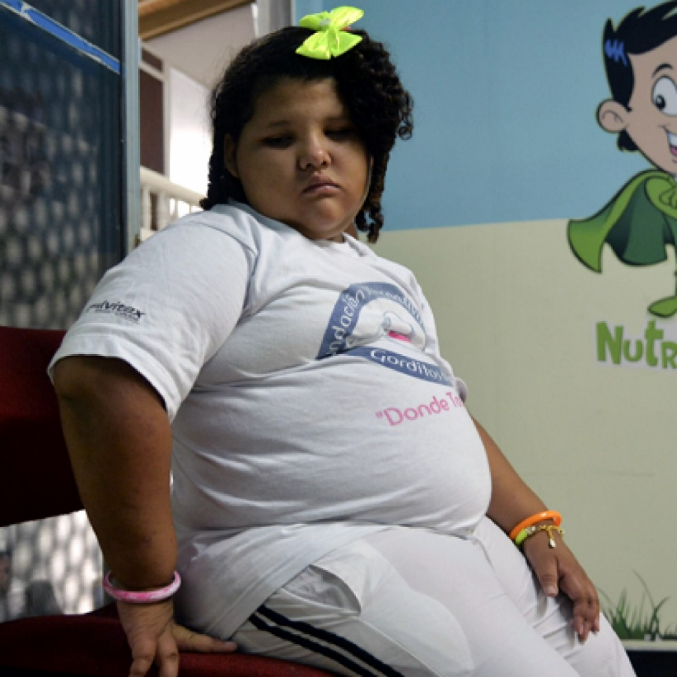
Prevalence in children and youth
Adolescents overweight
1999 = 28.8%; 2016 = 41.5%
Children 2-19
Obesity: Was 19.7% but increased to
22% during the pandemic
Overweight: 44.6%
Severe obesity in teens = 7.6%
57% predicted to be obese by age 35
Emerging adults (18-25)
Obesity: 32.7% in 2018 (was 6.2% in 1980)

Slide 14
Causes of Obesity
First law of thermodynamics: imbalance between calories in/calories out
Plus appetite regulation, eating behavior, and physical activity patterns
Biological
Increase in the number of fat cells or increase in the size of the fat cells
Harder to treat obesity caused by increased number of fat cells because fat cells can be reduced in size but not in number
With obesity, cells in adipose (fatty) tissues start to malfunction and produce inflammatory chemicals that cause illnesses

Slide 15
Causes of Obesity
Genetic/chromosomal
Prader-Willi, Down Syndrome, Turner syndrome, MC4R mutation
Genes regulate how the body uses, stores, and releases energy from food
Adoption studies: BMI more strongly correlated with biological parent
Hormonal: Hypothyroidism, Cushing syndrome, polycystic ovary syndrome (PCOS)
Medications: Cortisone/corticosteroids, oral contraceptives, tricyclic antidepressants, Risperidone, Clozapine
Environmental: food insecurity and only a high school education
Psychological/ sociocultural
Children as young as 4 eat 79% more calories when bored compared to when they are in a neutral mood

Slide 16
Normal Hormone Regulation of Hunger and Satiety
Leptin – regulates appetite by signaling hypothalamus that the body is full or satiated
Made by fat cells – so more fat cells, more leptin
Ghrelin – signals hunger
Leptin and Ghrelin work opposite each other; leptin inhibits ghrelin
Ghrelin is made in the stomach
Insulin – regulates satiety by allowing cells to use glucose for energy or stored as glycogen or fat; insulin is proinflammatory
Can interfere with signals sent by leptin
Can result in insulin resistance
Increased intake results in increased insulin and interferes with signals for satiety; glucose is converted to fat and body stops responding to the insulin (insulin resistance) resulting in weight gain

Slide 17
Disruptions to physiologic appetite regulation that can cause weight gain
Sleep disturbances
Increased stress levels
Diabetes
Insulin resistance
Polycystic ovary syndrome
Menses and changing hormonal levels
Gut microbiota (especially between ages 3.5 and 5)
Altered neurotransmitters (especially dopamine and serotonin)
Emotional: “Food gives me hugs” – (bypasses hunger/ satisfaction signals)

Slide 18
More questions and issues
Do we eat because we are hungry or because it is time?
Are we aware of what satiety feels like?
Do we eat what is the easiest to grab and go or take the time to make something healthy?
How do the child’s role models/ peers eat?
Are meals eaten primarily in or out of the home?
Outside the home are usually larger portions and more calories
Do we eat the AMOUNT served or limit that amount
Is food used as a reward in school/ home for good behavior and achievement? Is food used for comfort? Do we eat the meal in order to get dessert?
Makes foods and sweets desirable and associated with “positives”
Do we primarily celebrate with food? (birthdays, holidays, achievements)
Do you eat to live or live to eat?
Food should just be nourishment
Do you have to clean your plate?

Slide 19
Changes in U.S. Dietary Patterns
Portion sizes have increased
27% of calories by children/teens is through snacks
Sugar-sweetened soda and fruit juices = 18.7% of total consumption
Decreased milk and calcium intake
Only 60% have one fruit and one vegetable each day
The average American consumes 640 calories of added fats per day
15% of kids do not eat breakfast
NOTE: Females need 17% body fat to start menses and 22% to maintain it

Slide 20
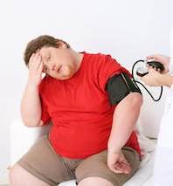
Consequences of Obesity
Obesity is both a disease and a risk factor for other chronic conditions
70% of children who are obese have at least one risk factor for cardiovascular disease (dyslipidemia, hypertension, insulin resistance)
Hypertension
Affects 2%-13% of children and adolescents
Caused by obesity, stress, sedentary behaviors
Be sure to use a larger cuff
Prehypertension is BP>90th to <95th percentile for age, sex, and height
Hypertension is >95th percentile
Hyperlipidemia, hypercholesterolemia, HEART DISEASE
Results in atherosclerosis and left ventricular hypertrophy
Results in fatty liver disease
Second leading cause of preventable death – after smoking
Obese children are more than twice as likely to die before the age of 55 compared with healthy-weight children

Slide 21
Pre-diabetes
Nearly 1:5 adolescents are pre-diabetic
Fasting glucose >100mg/dL or random glucose >150mg/dL
OR hemoglobin A1c >5.9%
Risk of T2DM increases substantially with A1c > 6%
Worsening of obesity is strongly associated with T2DM progression

Slide 22
Consequences of Obesity
Diabetes mellitus, Type 2
Rarely seen in youth before 1990
Used to be 5% of children with diabetes had type 2; now it is 32%
67/100,000 youth
At least half are obese
Especially prevalent in Native Americans
Impacts glucose metabolism, resulting in hyperinsulinemia, insulin resistance, impaired glucose tolerance
Fasting blood glucose of >126 mg/dL or random plasma glucose of >200 mg/dL in a patient with symptoms

Slide 23
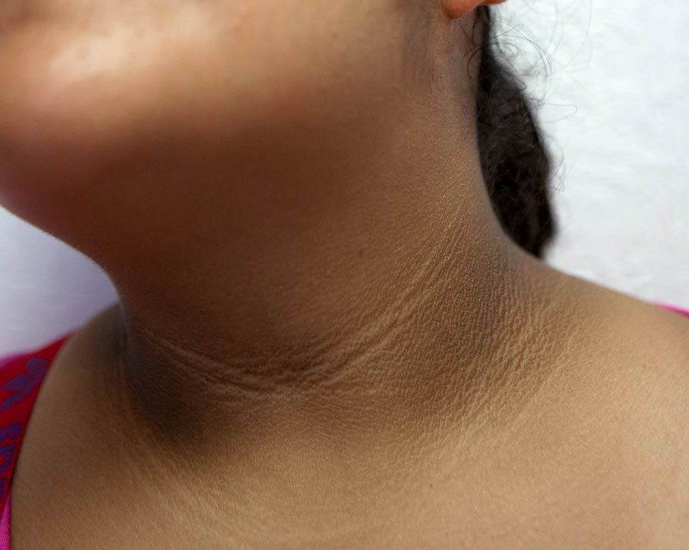
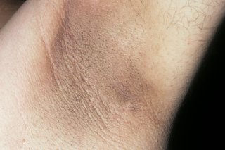
Consequences of Obesity
Diabetes mellitus, Type 2
Acanthosis nigricans seen in 90% of patients and strongly associated with obesity and hyperinsulinemia
Patch of skin (neck, armpit, groin) that thickens, darkens and feels velvety; may itch or smell
Does not necessarily predict the disease
Associated with thickening of carotid artery

Slide 24
Consequences of Obesity
Exacerbation of asthma and other respiratory problems
Overweight children are 17% more likely to have an asthma diagnosis and obese children are 26% more likely
23%-27% of new asthma cases in children with obesity may be directly related to obesity
The frequency and degree of bronchospasm in children with asthma are significantly greater in those who are obese, possibly due to the pro-inflammatory state of obesity
Larger body mass increases oxygen consumption

Slide 25
Consequences of Obesity
Sleep disorders
Poor sleep quality: children who are overweight sleep less, have more disrupted sleep time
Sleep apnea occurs in 60% of children who are obese due to airway obstruction
Musculoskeletal disorders
Increased risk of musculoskeletal injury
More weight is on immature skeletons
Slipped Capital Femoral Epiphysis, Blount’s disease (tibia vara), and fractures
Joint pain makes it harder to engage in activity

Slide 26
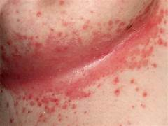
Consequences of obesity
Skin breakdown and altered ability to perform self hygiene
Bathroom stalls are too small to close door or spread legs to wipe
Unable to reach rectum to wipe
Skin breakdown in intertriginous areas: between fat rolls, breasts, thighs; burning discomfort

Slide 27
Consequences of obesity
Early sexual maturation in females in females who are overweight (especially between ages 2 and 6)
Fat cells have the ability to manufacture estrogen, initiating puberty
Ingestion of growth hormones, pesticides, PCBs that mimic estrogen
Psychosocial/Mental Health Issues
Depression, anxiety, eating disorders
Social isolation, bullying, low self esteem
Can result in school avoidance and increased emotional eating
Desks and chairs may be too small to accommodate their bodies; uniforms may be inappropriate and unflattering

Slide 28
13 Obesity-Related Cancers in Adults
Pancreatic
Adenocarcinoma of the esophagus
Gall bladder
Colorectal
Breast cancer in post menopausal women
Uterine
Ovarian
Kidney
Gastric cardia (near sphincter)
Liver
Thyroid
Meningioma (benign)
Multiple myeloma

Slide 29
The stigma of obesity
Long stigmatized as a reversible consequence of personal choices (seen as lazy, lacking will power and self control, dull, and slovenly
Results in weight stigma, victimization, shaming, teasing and bullying which contribute to binge eating, social isolation, avoidance of healthcare services, and decreased physical activity.
Results in decreased mental health, embarrassment, shame, sadness
Avoid label by using ‘person-first’ language
Youth prefer term: healthy weight
Dislike: obese, fat, large

Slide 30
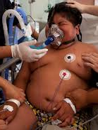
Obesity is a disability; what accommodations do they need?
We treat the consequences of obesity…rather than managing the underlying condition
Part of the blame is insurance companies; part of the blame is on healthcare providers

Slide 31
Interventions
Start with a conversation: Do they want to lose weight?
Ask what they eat (bored, angry, lonely, hungry, social), their weekly activity, the barriers they face, their wishes, do they blame anyone, do they believe it will affect their health, are they embarrassed to ask for help?
Is the goal weight loss or improved health?
Make the goal realistic in time and amount
What would motivate you?

Slide 32
Obesity: Interventions
How much do I need/want to lose?
Normalizing body weight is NOT required
Think percent of weight rather than pounds???
With 5% weight loss (10 pounds for someone 200 pounds)
Visceral fat is reduced by 9%
Insulin sensitivity in the liver and adipose tissue is greatly improved
Blood pressure improvement can be seen

Slide 33
Goal for young children is not to lose weight; just not to gain weight
Approach it as a disease.
There is no failure – just an oops
If you fall down, get up; don’t stay on the ground
Don’t start tomorrow, Monday, next month; start now

Slide 34
When to start
US Preventive Services Task Force recommends age 6 to teach about diet and exercise (but no research)
Another study indicated that teaching about healthy eating and activity can safely start between ages 4 and 6

Slide 35
Clinical Practice Guidelines for the Evaluation and Treatment of Children and Adolescents with Obesity
American Academy of Pediatrics, January 9, 2023

Slide 36
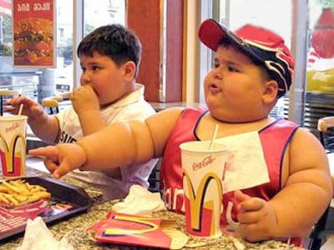
Pediatric Guidelines on Obesity (AAP)
Look at the whole picture
See children with obesity regularly
Comprehensive intensive health behavior lifestyle treatment
Face to face, family-based, multidisciplinary counseling on
Nutrition (what we eat)
Physical activity (what we do)
Behavioral therapy (what we think)
26 hours over at least 3-12 months
Medication
Bariatric surgery

Slide 37
Lifestyle interventions are the foundation of management
BUT
They have limited effectiveness and durability
They result in the least weight loss but they are the safest

Slide 38
Food/ Nutrition
Have children and youth select the meals or look at menus, and help shop for and prepare the meal
Put fork down between bites
Have low calorie, colorful foods available easy to grab (washed and in front of the refrigerator or in small bags) [fruit, vegetables cut up, yogurt, trail mix]
Serve EVERYONE correct portion size; use smaller plates
Dessert does not have to be part of a meal; perhaps for special occasions
No specific diet recommended for children

Slide 39
Prevention via School Nurses
Promote a healthful diet, activity and environment
Messages about nutrition and activity should be on bulletin boards, school websites, columns in school or community paper, health information sent home to parents
Science projects on the amount of sugar in sodas.
Be a role model, even if you are overweight; you know how hard it is
Praise families who are initiating preventive and healthy measures

Slide 40
Prevention for families
Avoid skipping breakfast
Time-restricted eating is not for children (8-10 hours of eating; 5% weight loss)
Don’t force completion of meal; limit between-meal snacks
Do not focus on foods and how one looks; talk health
Have water or milk with meals; no juices or sugared beverages

Slide 41
Activity recommendations for children (Do NOT call it exercise)
For ages 3-5: they should be active throughout the day
Children 6-17 should engage in 60 minutes of moderate to vigorous aerobic physical activity every day (CDC) [a 7-8 out of 10 for 1-10 activity intensity]
Aerobic activity to increase heart rate (brisk walking at least 3/week)
Muscle strengthening (climbing monkey bars, push ups, gymnastics) 3/week
Bone strength (running, jumping, jump rope) 3/week
33%-43% of total bone mass is acquired in adolescent years; therefore bone health is important
Peak bone mass is age 30; therefore the more you have then, the later the development of osteoporosis
(Only 35% of male teens and 17% of female teens met this criteria)

Slide 42
Activity
Exercise is key component of lifestyle change for kids
Issue: Decreased physical education and recess in schools
17 states require physical education in elementary schools; 4 states mandate recess
Excuse is to improve performance on standardized tests
increased or maintained their grades and scores on standardized tests, increased their attention in the classroom and decreased off-task behaviors (fidgeting)
Exercise confers many benefits (improves insulin sensitivity, reduces blood pressure, redistributes fat)
Improves mood and well being ??
Do NOT assume that exercise makes you feel “better” afterwards; some feel miserable and have no endorphin release

Slide 43
Activity
Studies show ‘screen time’ interferes with activity
2/3 of children have a TV or tablet in their bedroom
AAP recommends 1 hour/day for those 2-5, no screen time in the bedroom or during family meals
Good sleep habits are tied to healthier weight
Issue: Is the community safe for activity?
Children are kept indoors due to crime and abductions
Avoid body image issues
Avoid associating activity/exercise with weight or weight loss
Do not say the exercise “is not long enough” or “not hard enough”
Talk about the benefits of exercise: better sleep, better concentration, being stronger, being healthier
Remember that Exercise Is Medicine

Slide 44
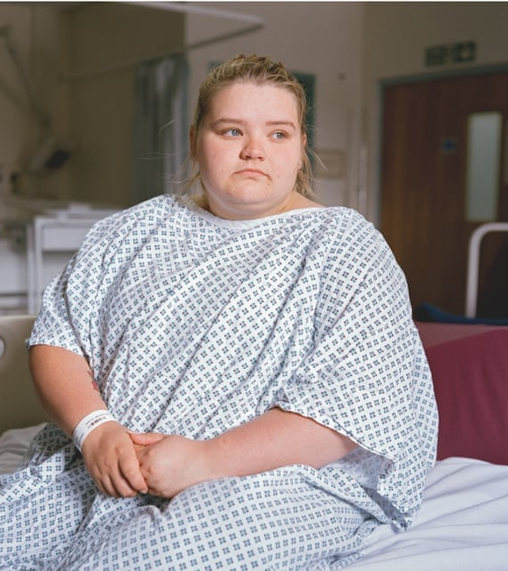
Exercise/Activity
Understand that one mile of walking uses 100 calories,
which equals 2 oreo cookies
Parental support and modeling is essential
What if you severely limit food and exercise vigorously and do not lose weight?
Starvation response
For adults, British study showed 8 minutes/d of vigorous activity improves health
Vigorous is increasing metabolic rate 6x the resting rate

Slide 45
Programs
Traffic light diet:
red light (high calorie foods that should be eaten rarely)
yellow light (moderate calorie foods that can be eaten occassionally)
green light (low calorie that can be eaten freely)
5-2-1-0
5 fruits and vegetables a day
2 hours or less of screen time
1 hour or more of vigorous activity
0 or nearly 0 sugar-sweetened beverages
Recommendations at myplate.gov

Slide 46
Bottom line…
Multicomponent behavior-changing interventions may be beneficial in achieving small, short-term reduction in BMI but the quality of evidence is low.
Behavior modification often fails
AAP does not support “watchful waiting” to see if children outgrow obesity; aggressive treatment is recommended
Ages 2-6 is the ideal time to make the most profound and
effective changes in lifestyle
Treat obesity as a chronic condition
If you fall down…..get up. Don’t stay there
Acknowledge slips

Slide 47
American Gastroenterological Association
In those obese or overweight with weight-related complications who have an inadequate response to lifestyle interventions – add pharmacologic agents
Meds result in better risk-to-benefit ratio
Do not use in pregnancy or with bulimia
Caution in those with T2DM who take insulin or sulfonylureas
Can result in hypoglycemia
Caution in those taking medications to lower blood pressure
Can result in increased risk of pancreatitis and gallbladder disease

Slide 48
Consider Medications
Medications approved as ADJUNCTS to a reduced calorie diet and increased exercise for chronic weight management
NOT recommended for those under age 12 (although some say OK for 8-11)
Different doses and different names than used for Type 2 diabetes
Agents approved for management (incretin hormones)
Glucagon-like peptide agonists (GLP-1) – for type 2 diabetes
GLP-1 receptors are concentrated in the pancreas, G.I. system, CNS, heart, lungs, kidneys, blood vessels, and peripheral nervous system
Results in increased insulin secretion and a delay in gastric emptying, decreased appetite and prolongs satiety
Not covered by insurance if no diabetes
Considered “vanity drugs” for obesity (although not when used for T2DM)

Slide 49
Medications
Semaglutide (Ozempic/Wegovy) – approved 2015/2021
Initial dose 0.25 mg weekly sq; increase in 4 weeks intervals to 2.4 mg
$1500/month
Gastroesophageal reflux, nausea, vomiting, diarrhea, constipation, abdominal pain, headache, fatigue
Efficacy – 17% at one year, depending on dose
Rybelsus (for T2DM) – oral tablet/$31
Tirzepatide (Mounjaro/Zepbound)
Semaglutide + glucose-dependent insulinotropic peptide analogue
10-15 mg/week sq
→ 22% weight loss
Liraglutide (Victoza/ Saxenda)– approved 2015 and 2020 for teens
Initial dose 0.6mg PER DAY sq for 1 week and increase weekly to 3 mg/d
Efficacy – 7.8% at one year

Slide 50
Less Commonly Used/ Less Effective Medications
Phentermine/topiramate (8%-10% loss)[Qsymia/Vivus]
12 and up; only for short term use
Lots of possible side effects, including suicidal thoughts
Cleft lip and palate risk in fetus
Suppresses appetite by increasing norepinephrine production
Naltrexone/bupropion (5% loss) [Contrave]
No longer recommended
Orlistat [Alli/Xenical]
Blocks fat absorption by inhibiting pancreatic and gastric lipase
Fen-Phen (resulted in heart valve lesions)

Slide 51
Bariatric Surgery
ONLY for those (10-18 ) who have a BMI of 35/ Class II Obesity (120% of the 95th percentile) and a co-morbidity, or >40
Roux-en-Y gastric bypass
Vertical (sleeve) gastrectomy
Laparoscopic adjustable gastric banding (not approved for <18)
Many insurance companies will not pay for <18
Impressive 3-year outcomes for those <19
Bypass: 29%
Sleeve: 27%
Greatest loss – but greatest risk

Slide 52
Issues
How should BMI results be communicated to families?
How do you approach interventions when the rest of the extended family are also overweight?
How to deal with weight stigma by peers, teachers, health professionals
Consider culture: if food is love, what does with-holding it mean? If my child does not look well-fed, will that make me look like a bad mother?
Is taking medication for weight loss a form of ‘self-harm’
What messages do healthcare providers give or do that are not helpful

Slide 53
Other Interventions
For ages 6-11: No one intervention is best. WHO guidelines promote multi-component behavior changing interventions
Include the family (or should the parents be the target)?
For teens:
Use multidisciplinary team (pediatrician, registered dietitian, exercise physiologist, and/or psychologist
Address quality and quantity of food
Consuming less ultra-processed foods, sugar-sweetened beverages, and other added sugar (read labels for sugar)
Eat regular meals; decrease portions, eat more fruits, vegetables and fiber
Limit amount of non-academic screen time
Try different approaches – everyone learns differently and at a different rate
(food logs, pedometers, pre-packaged meals)

Slide 54
Other Interventions
Communicate in a respectful, empathetic, and compassionate manner using appropriate terms
Cheer them on
Help them find clothing that is flattering and makes them feel good
Talk about toileting hygiene and skin care issues specific to those who are obese

Slide 55
Other Interventions
What accommodations do they need?
What is hardest for you (PE, bathroom, shaming, etc.)
Use person-first language
Support groups – not for everyone
Find their strengths – what makes them normal or above normal?

Slide 56
Prevention
Make it harder to advertise unhealthy foods and drinks
Fully fund physical education in the schools
Fund “Safe Routes to Schools” and other programs to walk and bike to school

Slide 57
In Conclusion…
Obesity is not a choice; it is not a lack of will power
It is a chronic condition; treatment should be implemented on a long-term basis (short term treatments may be associated with relapses)
There is no quick fix
Advocate for yourself
Just keep trying; it is not all or none – be realistic

